Slide 1
10/17/2024
Hello
こんにちは
Hej
Bonjour
Hallo
你好
Ciao
Shen
Notes:
Hello everyone, welcome to my trial lecture.
I try to say hello in your mother tongue.
If your mother tongue is, unfortunately, not listed here.
You may give a complaint at the end of this lecture.

Slide 2

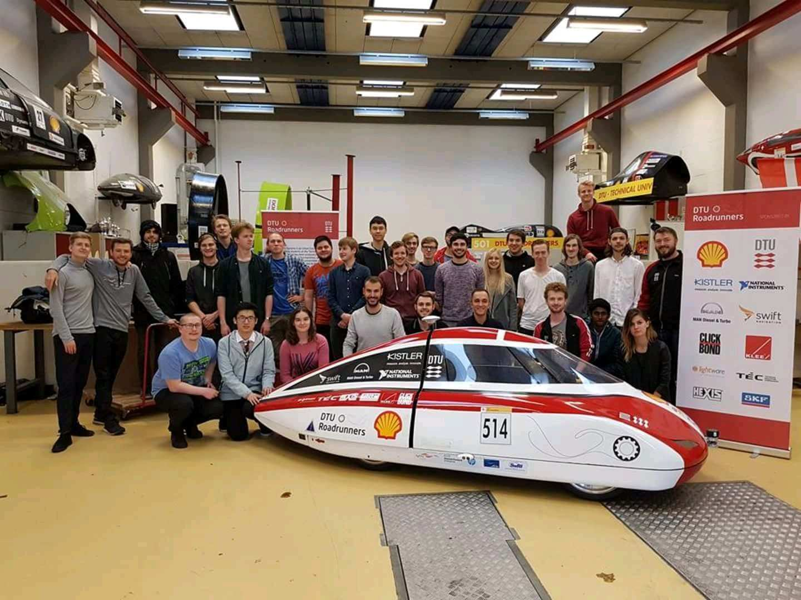
I
Self-Introduction: Shen
Birth
Master
(Technical University of Denmark)
Doctor
(The University of Tokyo)
1995
2017-2019
2020-2023
Notes:
I am your lecturer /ˈlek(t)SHərər/. My name is Shen. I am a Ph.D. in Aeronautics and Astronautics.
This slide gives my self-introduction. I was born in 1995.
In 2017, I started my master’s program at DTU in Denmark. At that time, I was studying in automation and robotics.
The left figure was our autonomous driving team at DTU.
After graduating from DTU, I came to Japan for a doctoral program in Aeronautics and Astronautics.
The charming figure on the right is the university of Tokyo.
My research focus in Tokyo was the drone controller design.

Slide 3
10/17/2024
Ph.D. in Aeronautics and Astronautics
Drone-based
control systems
Shen
Notes:
Today’s lecture is about the drone-based control systems.
Specifically, we will control a quadrotor by a pid controller.

Slide 4
Table of Contents
Page
I
Quadrotors and Dynamics
4
II
Controller Design
13
III
Summary
18
Notes:
We will visit the quadrotor and its dynamics first.
After that, we will control this quadrotor with a PID controller before we make a final summary.

Slide 5
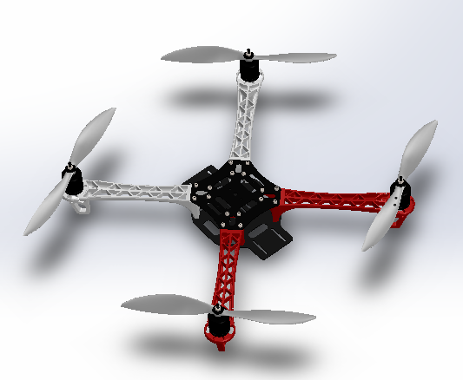
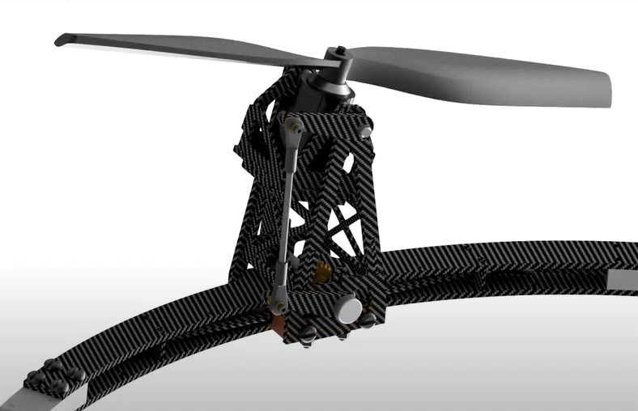
4
I
Quadrotors and Dynamics
The direction of the thrust is adjustable.
https://www.mathworks.com/matlabcentral/fileexchange/48052-simulate-quadrotor-in-simulink-with-simmechanics
Ryll, Markus, Heinrich H. Bülthoff, and Paolo Robuffo Giordano. "Modeling and control of a quadrotor UAV with tilting propellers." 2012 IEEE international conference on robotics and automation. IEEE, 2012.
Quadrotor
Tilt-rotor
Notes:
There are different kinds of quadrotors.
What you see on the left is a conventional quadrotor.
The direction of the thrust is upward.
On the right, we can see a tiltrotor.
(play the demo)
Different from the conventional quadrotor,
in a tiltrotor, the direction of the thrust is adjustable during the flight.

Slide 6
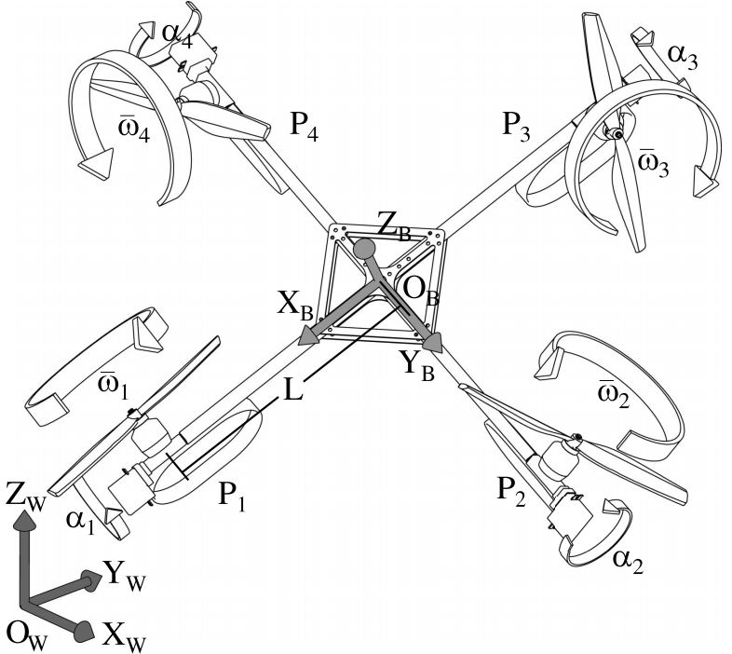
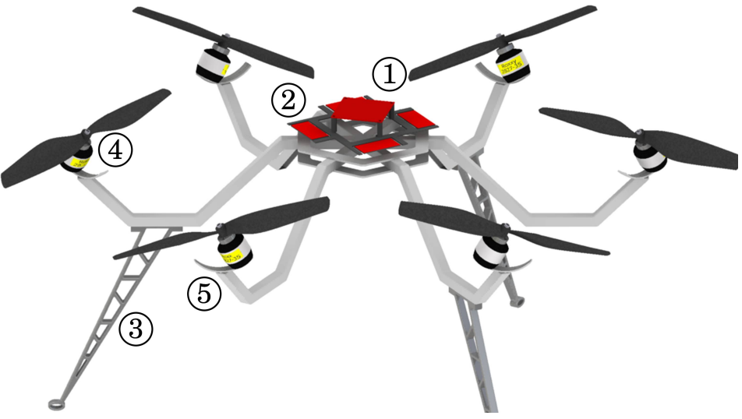
5
I
Quadrotors and Dynamics
Quadrotor
Tiltrotor
Tilted-rotor
The total control force can be produced only in one direction.
It is mechanically possible to change the structure of the tiltrotor.
Based on the trajectories, the optimal structure can be designed.
https://www.mathworks.com/matlabcentral/fileexchange/48052-simulate-quadrotor-in-simulink-with-simmechanics
Ryll, M., Bülthoff, H.H. and Giordano, P.R., 2012, May. Modeling and control of a quadrotor UAV with tilting propellers. In 2012 IEEE international conference on robotics and automation (pp. 4606-4613). IEEE.
Rajappa, S., Ryll, M., Bülthoff, H.H. and Franchi, A., 2015, May. Modeling, control and design optimization for a fully-actuated hexarotor aerial vehicle with tilted propellers. In 2015 IEEE international conference on robotics and automation (ICRA) (pp. 4006-4013). IEEE.
Notes:
Three relevant drones are listed here.
A conventional quadrotor can produce the total force only in one direction.
That is upward.
A tiltrotor can change its structure.
Therefore, a tiltrotor can change the direction of the thrust during the flight.
The third drone is called the tilted-rotor.
The tilted-rotor cannot change its structure.

Slide 7
6
I
Quadrotors and Dynamics
Quadrotor
Tiltrotor
Tilted-rotor
The total control force can be produced only in one direction.
It is mechanically possible to change the structure of the tiltrotor.
Based on the trajectories, the optimal structure can be designed.
https://www.mathworks.com/matlabcentral/fileexchange/48052-simulate-quadrotor-in-simulink-with-simmechanics
Ryll, M., Bülthoff, H.H. and Giordano, P.R., 2012, May. Modeling and control of a quadrotor UAV with tilting propellers. In 2012 IEEE international conference on robotics and automation (pp. 4606-4613). IEEE.
Rajappa, S., Ryll, M., Bülthoff, H.H. and Franchi, A., 2015, May. Modeling, control and design optimization for a fully-actuated hexarotor aerial vehicle with tilted propellers. In 2015 IEEE international conference on robotics and automation (ICRA) (pp. 4006-4013). IEEE.
Notes:
Today, we will control the conventional quadrotor.
As we mentioned, this quadrotor has four inputs.

Slide 8
7
I
Quadrotors and Dynamics
Quadrotor
Inputs
DoF
Inputs (4) < DoF (6)
The total control force can be produced only in one direction.
We cannot stabilize all the 6 DoF independently.
https://www.mathworks.com/matlabcentral/fileexchange/48052-simulate-quadrotor-in-simulink-with-simmechanics
Ryll, M., Bülthoff, H.H. and Giordano, P.R., 2012, May. Modeling and control of a quadrotor UAV with tilting propellers. In 2012 IEEE international conference on robotics and automation (pp. 4606-4613). IEEE.
Rajappa, S., Ryll, M., Bülthoff, H.H. and Franchi, A., 2015, May. Modeling, control and design optimization for a fully-actuated hexarotor aerial vehicle with tilted propellers. In 2015 IEEE international conference on robotics and automation (ICRA) (pp. 4006-4013). IEEE.
Notes:
These 4 inputs are the magnitudes of the 4 thrusts.
F1, F2, F3, F4, respectively.
On the other hand, there are 6 degrees of freedom.
They are roll, pitch, yaw, x, y, and z.
Note that the number of the inputs is less than the number of the degrees of freedom.
Therefore, these 6 DoF cannot be controlled simultaneously or independently.

Slide 9
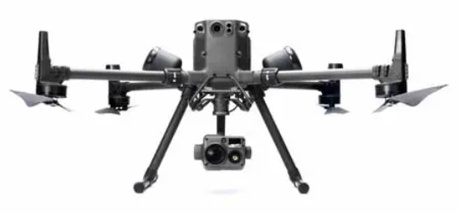
8
I
Quadrotors and Dynamics
Quadrotor
initial
goal
The total control force can be produced only in one direction.
We cannot stabilize all the 6 DoF independently.
https://www.mathworks.com/matlabcentral/fileexchange/48052-simulate-quadrotor-in-simulink-with-simmechanics
Ryll, M., Bülthoff, H.H. and Giordano, P.R., 2012, May. Modeling and control of a quadrotor UAV with tilting propellers. In 2012 IEEE international conference on robotics and automation (pp. 4606-4613). IEEE.
Rajappa, S., Ryll, M., Bülthoff, H.H. and Franchi, A., 2015, May. Modeling, control and design optimization for a fully-actuated hexarotor aerial vehicle with tilted propellers. In 2015 IEEE international conference on robotics and automation (ICRA) (pp. 4006-4013). IEEE.
Notes:
Let’s see a simple example here.
A drone is hovering at its initial position.
And it is expected to move to a goal position.
Someone may believe the drone can move without changing the attitude while moving.

Slide 10
8
I
Quadrotors and Dynamics
Quadrotor
initial
goal
The total control force can be produced only in one direction.
We cannot stabilize all the 6 DoF independently.
https://www.mathworks.com/matlabcentral/fileexchange/48052-simulate-quadrotor-in-simulink-with-simmechanics
Ryll, M., Bülthoff, H.H. and Giordano, P.R., 2012, May. Modeling and control of a quadrotor UAV with tilting propellers. In 2012 IEEE international conference on robotics and automation (pp. 4606-4613). IEEE.
Rajappa, S., Ryll, M., Bülthoff, H.H. and Franchi, A., 2015, May. Modeling, control and design optimization for a fully-actuated hexarotor aerial vehicle with tilted propellers. In 2015 IEEE international conference on robotics and automation (ICRA) (pp. 4006-4013). IEEE.
Notes:
Like this.

Slide 11
8
I
Quadrotors and Dynamics
Quadrotor
initial
goal
The total control force can be produced only in one direction.
We cannot stabilize all the 6 DoF independently.
https://www.mathworks.com/matlabcentral/fileexchange/48052-simulate-quadrotor-in-simulink-with-simmechanics
Ryll, M., Bülthoff, H.H. and Giordano, P.R., 2012, May. Modeling and control of a quadrotor UAV with tilting propellers. In 2012 IEEE international conference on robotics and automation (pp. 4606-4613). IEEE.
Rajappa, S., Ryll, M., Bülthoff, H.H. and Franchi, A., 2015, May. Modeling, control and design optimization for a fully-actuated hexarotor aerial vehicle with tilted propellers. In 2015 IEEE international conference on robotics and automation (ICRA) (pp. 4006-4013). IEEE.

Slide 12
8
I
Quadrotors and Dynamics
Quadrotor
initial
goal
The total control force can be produced only in one direction.
We cannot stabilize all the 6 DoF independently.
https://www.mathworks.com/matlabcentral/fileexchange/48052-simulate-quadrotor-in-simulink-with-simmechanics
Ryll, M., Bülthoff, H.H. and Giordano, P.R., 2012, May. Modeling and control of a quadrotor UAV with tilting propellers. In 2012 IEEE international conference on robotics and automation (pp. 4606-4613). IEEE.
Rajappa, S., Ryll, M., Bülthoff, H.H. and Franchi, A., 2015, May. Modeling, control and design optimization for a fully-actuated hexarotor aerial vehicle with tilted propellers. In 2015 IEEE international conference on robotics and automation (ICRA) (pp. 4006-4013). IEEE.
Notes:
Unfortunately, this is not true.
The roll and pitch cannot be zero while moving.

Slide 13
9
I
Quadrotors and Dynamics
Quadrotor
initial
goal
The total control force can be produced only in one direction.
We cannot stabilize all the 6 DoF independently.
https://www.mathworks.com/matlabcentral/fileexchange/48052-simulate-quadrotor-in-simulink-with-simmechanics
Ryll, M., Bülthoff, H.H. and Giordano, P.R., 2012, May. Modeling and control of a quadrotor UAV with tilting propellers. In 2012 IEEE international conference on robotics and automation (pp. 4606-4613). IEEE.
Rajappa, S., Ryll, M., Bülthoff, H.H. and Franchi, A., 2015, May. Modeling, control and design optimization for a fully-actuated hexarotor aerial vehicle with tilted propellers. In 2015 IEEE international conference on robotics and automation (ICRA) (pp. 4006-4013). IEEE.
Notes:
In contrast, the quadrotor has to change its attitude.

Slide 14
9
I
Quadrotors and Dynamics
Quadrotor
initial
goal
The total control force can be produced only in one direction.
We cannot stabilize all the 6 DoF independently.
https://www.mathworks.com/matlabcentral/fileexchange/48052-simulate-quadrotor-in-simulink-with-simmechanics
Ryll, M., Bülthoff, H.H. and Giordano, P.R., 2012, May. Modeling and control of a quadrotor UAV with tilting propellers. In 2012 IEEE international conference on robotics and automation (pp. 4606-4613). IEEE.
Rajappa, S., Ryll, M., Bülthoff, H.H. and Franchi, A., 2015, May. Modeling, control and design optimization for a fully-actuated hexarotor aerial vehicle with tilted propellers. In 2015 IEEE international conference on robotics and automation (ICRA) (pp. 4006-4013). IEEE.
Notes:
By adjusting the roll and pitch, the quadrotor will generate the lateral force.

Slide 15
9
I
Quadrotors and Dynamics
Quadrotor
initial
goal
The total control force can be produced only in one direction.
We cannot stabilize all the 6 DoF independently.
https://www.mathworks.com/matlabcentral/fileexchange/48052-simulate-quadrotor-in-simulink-with-simmechanics
Ryll, M., Bülthoff, H.H. and Giordano, P.R., 2012, May. Modeling and control of a quadrotor UAV with tilting propellers. In 2012 IEEE international conference on robotics and automation (pp. 4606-4613). IEEE.
Rajappa, S., Ryll, M., Bülthoff, H.H. and Franchi, A., 2015, May. Modeling, control and design optimization for a fully-actuated hexarotor aerial vehicle with tilted propellers. In 2015 IEEE international conference on robotics and automation (ICRA) (pp. 4006-4013). IEEE.
Notes:
And this lateral force pushes it horizontally.

Slide 16
9
I
Quadrotors and Dynamics
Quadrotor
initial
goal
The total control force can be produced only in one direction.
We cannot stabilize all the 6 DoF independently.
https://www.mathworks.com/matlabcentral/fileexchange/48052-simulate-quadrotor-in-simulink-with-simmechanics
Ryll, M., Bülthoff, H.H. and Giordano, P.R., 2012, May. Modeling and control of a quadrotor UAV with tilting propellers. In 2012 IEEE international conference on robotics and automation (pp. 4606-4613). IEEE.
Rajappa, S., Ryll, M., Bülthoff, H.H. and Franchi, A., 2015, May. Modeling, control and design optimization for a fully-actuated hexarotor aerial vehicle with tilted propellers. In 2015 IEEE international conference on robotics and automation (ICRA) (pp. 4006-4013). IEEE.

Slide 17
9
I
Quadrotors and Dynamics
Quadrotor
initial
goal
The total control force can be produced only in one direction.
We cannot stabilize all the 6 DoF independently.
https://www.mathworks.com/matlabcentral/fileexchange/48052-simulate-quadrotor-in-simulink-with-simmechanics
Ryll, M., Bülthoff, H.H. and Giordano, P.R., 2012, May. Modeling and control of a quadrotor UAV with tilting propellers. In 2012 IEEE international conference on robotics and automation (pp. 4606-4613). IEEE.
Rajappa, S., Ryll, M., Bülthoff, H.H. and Franchi, A., 2015, May. Modeling, control and design optimization for a fully-actuated hexarotor aerial vehicle with tilted propellers. In 2015 IEEE international conference on robotics and automation (ICRA) (pp. 4006-4013). IEEE.
Notes:
And finally making it reach the goal.

Slide 18
10
I
Quadrotors and Dynamics
Quadrotor
initial
goal
DoF
Inputs (4) < DoF (6)
The total control force can be produced only in one direction.
We cannot stabilize all the 6 DoF independently.
https://www.mathworks.com/matlabcentral/fileexchange/48052-simulate-quadrotor-in-simulink-with-simmechanics
Ryll, M., Bülthoff, H.H. and Giordano, P.R., 2012, May. Modeling and control of a quadrotor UAV with tilting propellers. In 2012 IEEE international conference on robotics and automation (pp. 4606-4613). IEEE.
Rajappa, S., Ryll, M., Bülthoff, H.H. and Franchi, A., 2015, May. Modeling, control and design optimization for a fully-actuated hexarotor aerial vehicle with tilted propellers. In 2015 IEEE international conference on robotics and automation (ICRA) (pp. 4006-4013). IEEE.
Notes:
So, the next time your boss is asking you, “Why cannot the drone maintain the zero Euler angles while moving?”
You may reply, “The number of the inputs is less than the number of the degrees of freedom.”

Slide 19
11
I
Quadrotors and Dynamics
Quadrotor
initial
goal
DoF
Inputs (4) < DoF (6)
The total control force can be produced only in one direction.
We cannot stabilize all the 6 DoF independently.
https://www.mathworks.com/matlabcentral/fileexchange/48052-simulate-quadrotor-in-simulink-with-simmechanics
Ryll, M., Bülthoff, H.H. and Giordano, P.R., 2012, May. Modeling and control of a quadrotor UAV with tilting propellers. In 2012 IEEE international conference on robotics and automation (pp. 4606-4613). IEEE.
Rajappa, S., Ryll, M., Bülthoff, H.H. and Franchi, A., 2015, May. Modeling, control and design optimization for a fully-actuated hexarotor aerial vehicle with tilted propellers. In 2015 IEEE international conference on robotics and automation (ICRA) (pp. 4006-4013). IEEE.
Notes:
With only 4 inputs in total,
we will control roll, pitch, yaw, and altitude independently.
To control this quadrotor, we will check its dynamics first.

Slide 20

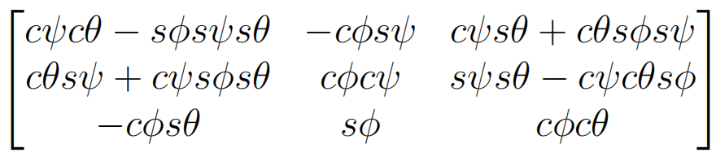

12
I
Quadrotors and Dynamics
Dynamics
Inputs:
DoF:
Note:
Notes:
What you see on this slide are the dynamic equations of a quadrotor.
I know there are lots of variables.
But don’t be scared.
When you see the complicated equations,
You may observe the inputs and outputs first.
The inputs are the four thrusts, F1, F2, F3, and F4, respectively.
They are here.
The outputs are 6 degrees of freedom.
Phi, theta, psi, X, Y, Z.
Here are the outputs.
This is the dynamics of a quadrotor.
These equations tell us how these degrees of freedom respond to the inputs in a quadrotor.
And we will control this quadrotor after linearizing these dynamic equations.

Slide 21
13
II
Controller Design
Dynamics (after linearization)
Inputs:
Linearize at
DoF:
initial
goal
Notes:
Linearize the dynamics at this equilibrium.
With the small angle approximation, we receive these relationships.
Focus on the result on the left.
The inputs are the four thrusts, F1, F2, F3, and F4.
The outputs are the four degrees of freedom.
They are the altitude, Z, the roll, pitch, yaw angles.
So, these 4 degrees of freedom are controlled independently by the inputs.
Now, let’s check the other part of the linearization.
Focus on the result on the right.
We also color the inputs and outputs.
But wait.
Where are the inputs?
There are no inputs in the equations on the right.
It means that the position is coupled with the attitude.
You may remember, the attitude cannot be zero while the drone moves.
These two equations explain this phenomenon.
We cannot control all 6 degrees of freedom independently.
Actually, these two equations between the attitude and the position are widely used in the setpoint tracking problem.

Slide 22
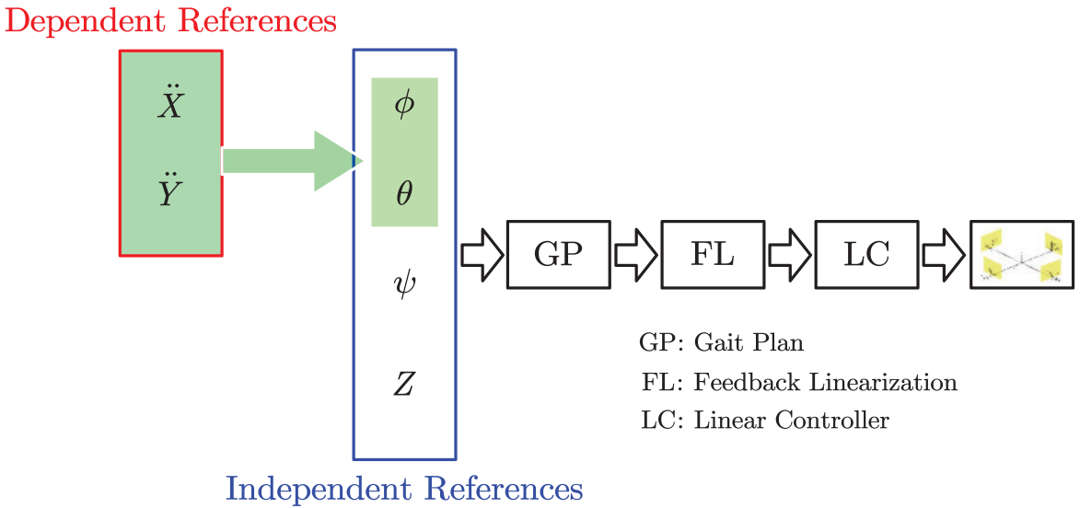
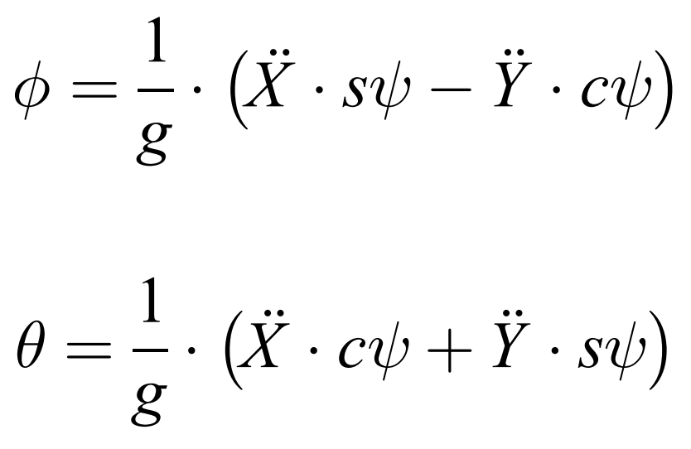
14
IV
II
Controller Design
The Coupled Position and Attitude
Linearize at
quadrotor
Shen Z, Ma Y, Tsuchiya T. Feedback linearization-based tracking control of a tilt-rotor with cat-trot gait plan. International Journal of Advanced Robotic Systems. 2022;19(4). doi:10.1177/17298806221109360
Notes:
Having this conventional relationship, we can control the position X and Y depending on the attitude.
The figure on the right is from a publication in the quadrotor control.
As we can see, the independent degrees of freedom to be directly controlled are the attitude and altitude.
The position X and Y are controlled by the coupling relationship between the position and the attitude.
In short, we will control the attitude and altitude directly.
And in this first lecture, we will learn how to stabilize the altitude.

Slide 23
15
II
Controller Design
Altitude Control
Notes:
To make the altitude control,
let’s focus on this dynamic equation after linearization.
To make our deduction easier,
we simplify this equation by assigning the right side as u1.
And, we will design the PID controller relying on this dynamic equation.

Slide 24
16
II
Controller Design
Altitude Control (PID controller)
P I D
P I D
Proportional
Integral
Derivative
Notes:
Delta z in this dynamic equation is the difference between the desired altitude and the actual altitude.
If you read the literatures, delta Z is sometimes called the state error.
Our goal is to let Z be equal to Z reference.
In other words, we need to find the input u1,
This u1 will finally make delta Z to be zero.
Here, we introduce a PID controller.
The PID controller is the abbreviation of proportional, integral, and derivative controller.
The Proportional part is the delta Z.
The Integral part is the integral of delta Z.
The Derivative part is the derivative of delta Z.
And a PID controller is the linear combination of the Proportional, Integral, and Derivative part.
The sum is the input of the quadrotor. The quadrotor will be maneuvered by this u1.

Slide 25
17
II
Controller Design
Altitude Control (PID controller)
P I D
Goal: 5 m
Lift the quadrotor from 0 meter to 5 meters.
MATLAB
Simulink
Initial: 0 m
https://github.com/HansOersted/trial_lecture
Notes:
Let’s use this PID controller to stabilize the quadrotor.
Assume a quadrotor is hovering at 0 meter.
And, it is desired to reach the goal at 5 meters.
We will use the PID controller on the right.
The coefficients, Kp, Ki, Kd are specified below.
On the top, you can check the final input.
To demonstrate the behavior of this controller,
I built the simulator in MATLAB.
For the interested researchers, this is the github link.
If you open this link,

Slide 26

https://github.com/HansOersted/trial_lecture
Notes:
You will get access to the simulator on my github.
I recommend my students to download and play with it after the lecture.
If you do so and open my simulator,

Slide 27
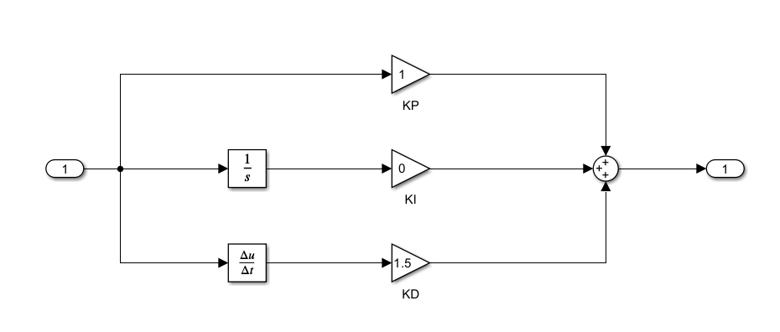
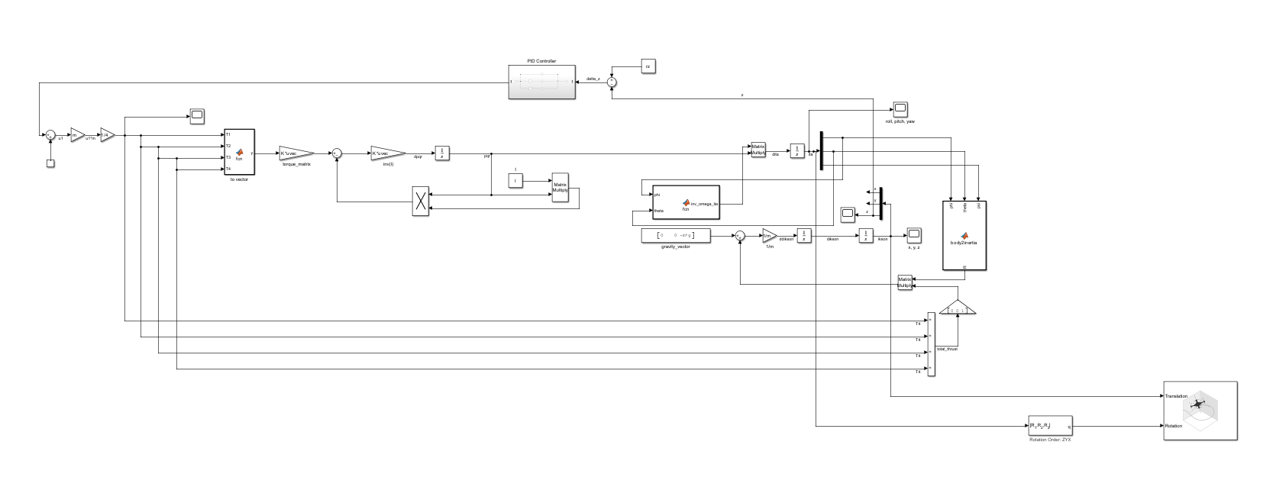
Controller
Dynamics
https://github.com/HansOersted/trial_lecture
Notes:
You will see this Simulink file.
It is the digital twin of the quadrotor.
The dynamic equations we saw earlier were constructed here.
And the controller, the PID controller, was built here.
In short, we will use the PID controller to stabilize the quadrotor in this simulator.
Let’s visualize the result.

Slide 28
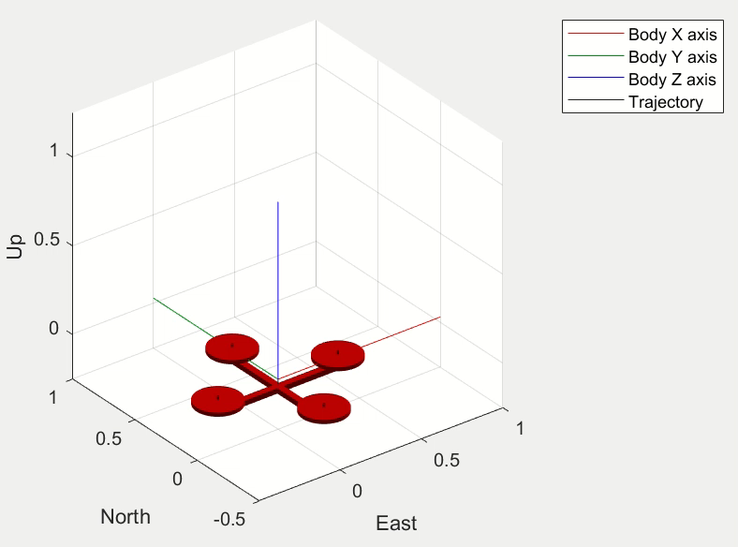
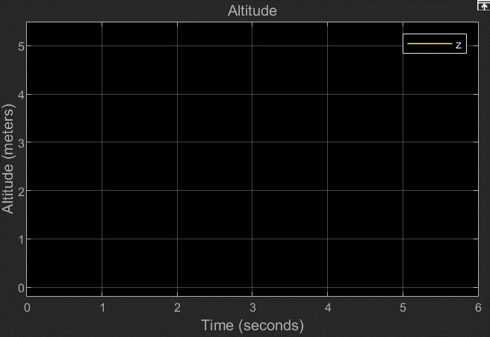
18
II
Controller Design
Altitude Control (PID controller)
P D
The Altitude of The Quadrotor
https://github.com/HansOersted/trial_lecture
Notes:
On the left, we will see the animation of the quadrotor.
The altitude of the quadrotor will be plotted on the right.
(play the video)
In the simulator,
the drone lifts from 0 to 5 meters as expected.
It means that our PID controller works!
I recommend you to change the coefficients in our controller.
For example, you may change the Kp to another value instead of 1.0 and check the result.
By doing so, you may find some interesting behaviors of the PID controller.
And please write to me if you have these experiences after this class.

Slide 29

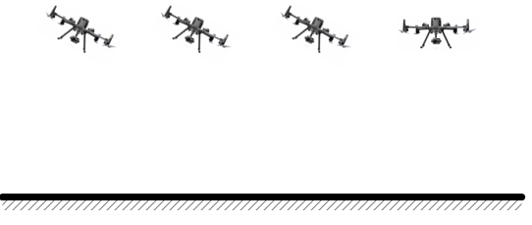
19
III
Summary
What you have learned today
Quadrotor
Independent DoF
Dynamics
The total control force can be produced only in one direction.
The controller can only stabilize 4 DoFs independently. They are roll, pitch, yaw, and altitude.
How the 6 DoF are influenced by the inputs.
Notes:
I’ll summarize what we have learned today.
Firstly, the quadrotor was introduced.
We then analyzed the dependencies between the degrees of freedom.
Next, we talked about how these degrees of freedom were influenced by the inputs.
That is the dynamics of the quadrotor.
With the dynamics of the quadrotor, we developed a controller.

Slide 30
20
III
Summary
What you have learned today
P:
I:
D:
PID controller
Altitude control
PID controller is proportional- Integral-derivative controller.
The altitude of the quadrotor is stabilized by a PID controller.
Notes:
A PID controller in specific, to stabilize the quadrotor.
We use this PID controller to make the altitude control.

Slide 31

21
III
Summary
What you will learn…
Stability proof
Attitude control
Why can PID controller stabilize the quadrotor?
How to stabilize the roll, pitch, yaw angles?
Notes:
In the next lesson, we will revisit the PID controller.
We will see Why a PID controller can stabilize the quadrotor.
Also, we will make the attitude control.
So far, we’ve only learned the altitude control.
You will learn how to make the position tracking control in the next lecture.
That’s all from my side in the first lecture.

Slide 32
10/17/2024
Ph.D. in Aeronautics and Astronautics
Thank you for
your attention
Shen
Notes:
Thank you for your attention.
As far as I know, in today's lecture, there can be audiences at the beginner’s level.
So, I leave about 5 minutes for you.
Let me know if you have questions or comments.

Slide 34
10/17/2024
Ph.D. in Aeronautics and Astronautics
Research &
Teaching Concept
Shen
Notes:
In the following 10 minutes, I will talk about my research and teaching concept.

Slide 35
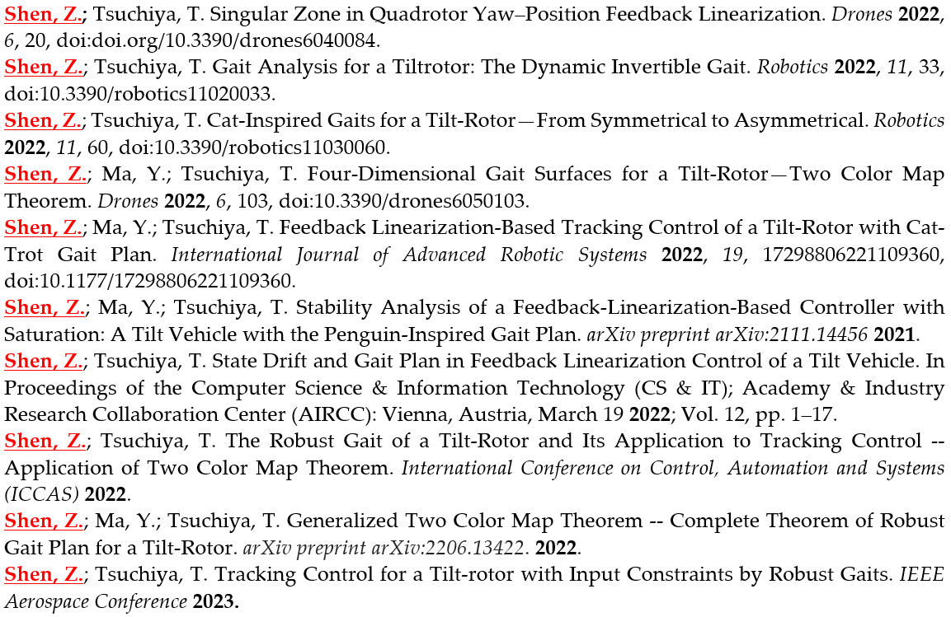
1
I
Research
Birth
Master
(Technical University of Denmark)
Doctor
(The University of Tokyo)
1995
2017-2019
2020-2023
English (Native)
Chinese (Mother Tongue)
Japanese (Medium)
Danish (Beginner)
Notes:
I’ll begin with my research.
This page lists some of my research publications during my doctoral program.
All of them are about robot simulator and robot control.
My primary contribution during my doctoral program was about the control theory and its application on the drones.

Slide 36
2
I
Research
The direction of the thrust is adjustable.
Tiltrotor Dynamics
4 magnitudes
Ryll, Markus, Heinrich H. Bülthoff, and Paolo Robuffo Giordano. "Modeling and control of a quadrotor UAV with tilting propellers." 2012 IEEE international conference on robotics and automation. IEEE, 2012.
4 tilting angles
Tilt-rotor
Notes:
The drone that I was focusing on during my doctoral program was called tiltrotor.
We introduced the tiltrotor in the trial lecture.
(play the demo)
There are 8 inputs in the tiltrotor.
They are 4 magnitudes of the thrusts and 4 directions of the thrusts.
We use a term called tilting angles to define the directions of the thrusts.

Slide 37
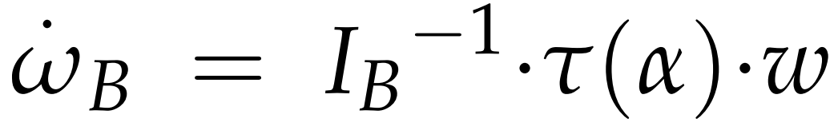

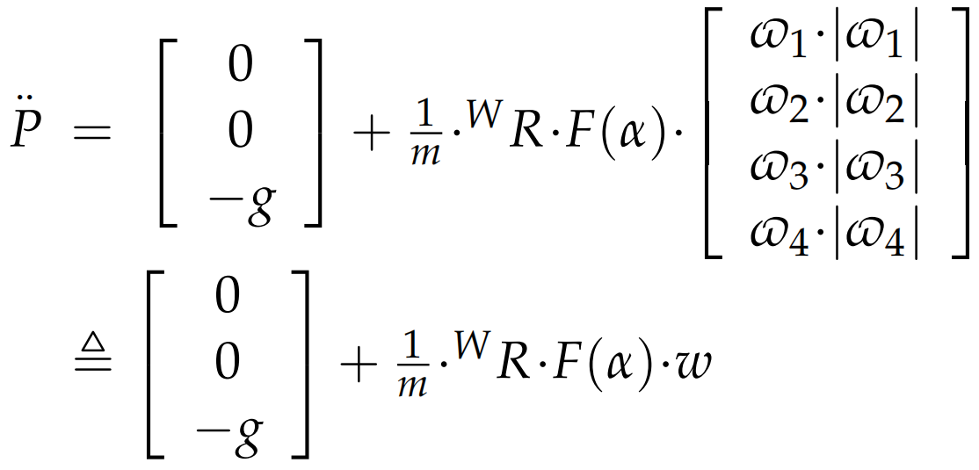

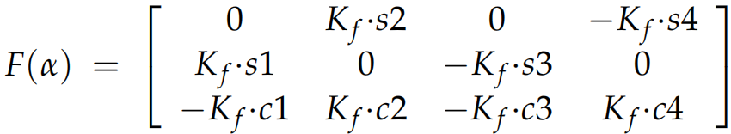

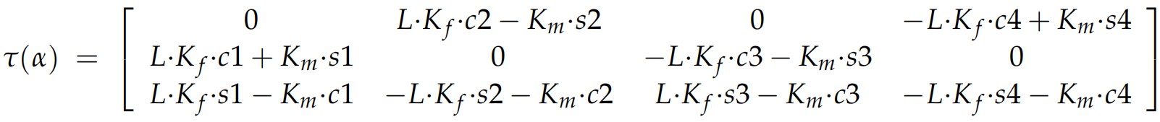
3
I
Research
The direction of the thrust is adjustable.
Tiltrotor Dynamics
Ryll, Markus, Heinrich H. Bülthoff, and Paolo Robuffo Giordano. "Modeling and control of a quadrotor UAV with tilting propellers." 2012 IEEE international conference on robotics and automation. IEEE, 2012.
where
Tilt-rotor
Shen, Z. and Tsuchiya, T., 2022. Gait analysis for a tiltrotor: The dynamic invertible gait. Robotics, 11(2), p.33.
Notes:
Here, we can see the dynamics of the tiltrotor.
The position and the attitude are governed by the 4 magnitudes and 4 directions of the thrusts, or we call them tilting angles.
My research focus was stabilizing the tiltrotor by feedback linearization.
Feedback linearization is a popular control method widely adopted in robotics.
I will brief the difficulties in applying feedback linearization from the next slide.

Slide 38
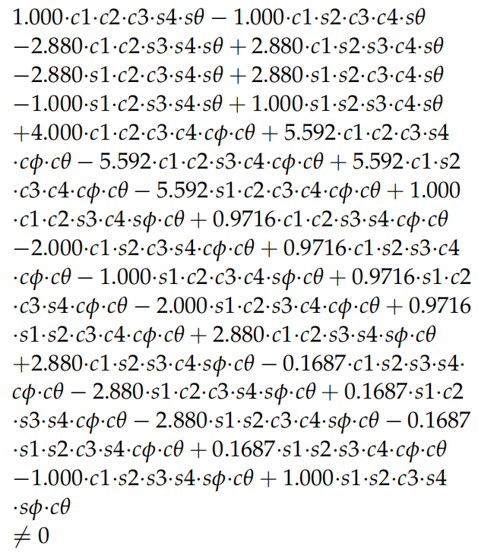
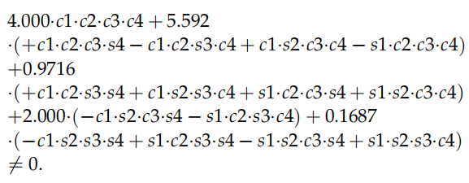
4
I
Research
Singularity in Attitude-Altitude Linearization in Tiltrotors
where
Before the flight, roll and pitch are not determined.
Therefore, the gait will be designed based on the simplified determinant.
A gait, satisfying the simplified determinant, may still violate the original determinant.
Notes:
In applying feedback linearization, a singular decoupling matrix is not expected.
What you see here is the determinant of the decoupling matrix.
There are 6 variables in this determinant.
They are roll, pitch, and four tilting angles, alpha1, alpha2, alpha3, and alpha4.
To receive the invertible decoupling matrix, the determinant should be non-zero.
If we assign both roll and pitch zero, we receive a simplified determinant.
There are only 4 variables in the simplified determinant.
They are the tilting angles alpha1, alpha2, alpha3, alpha4.
In my research, these tilting angles are pre-defined by a user-defined procedure.
I created this procedure for the first time and called it Gait Plan.
Gait Plan determines the tilting angles alpha1, alpha2, alpha3, alpha4, in advance.
As we know, before the flight, neither roll nor pitch is determined.
Having no information about phi or theta, we cannot use the left formula.
Therefore, the gait (alpha1 alpha2 alpha3 alpha4) can only be planned based on this simplified determinant
Because we have no information about phi or theta in the left formula before the flight.
However, a gait, satisfying the formula on the right, may still violate the formula on the left.
This is because that rolls and pitches maybe non-zero.

Slide 39
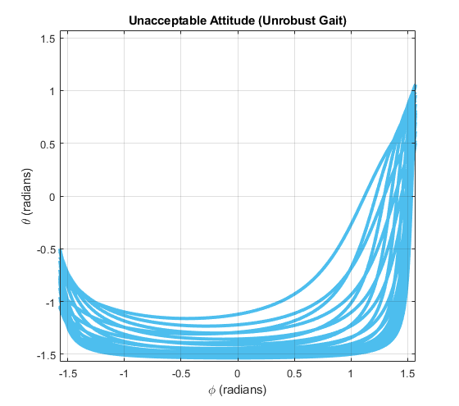
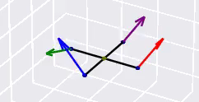

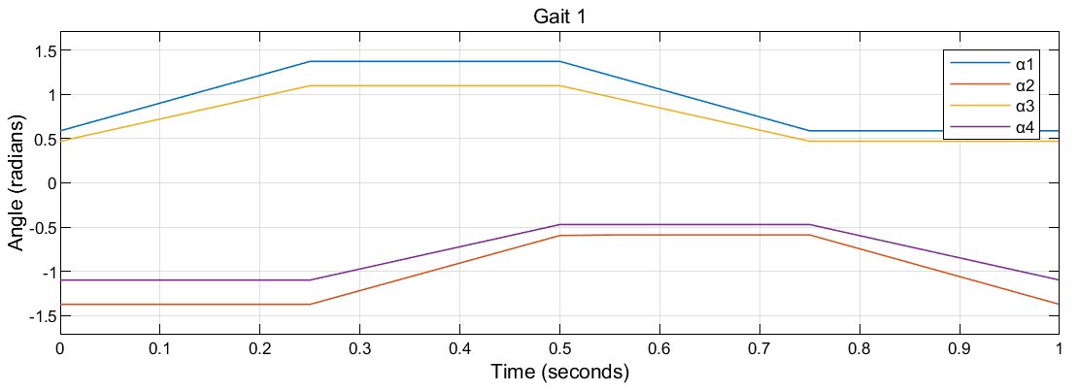

5
I
Research
Singularity in Attitude-Altitude Linearization in Tiltrotors
A gait, satisfying the simplified determinant, may still violate the original determinant.
Notes:
For example,
(play the demo)
this gait receives nonzero in the simplified determinant.
However, for some attitudes, the original determinant is zero.
Specifically, the rolls and pitches marked in blue in this figure result in the zero determinant.
These blue curves represent the unacceptable attitudes that lead to the singular decoupling matrix.
Traveling to the unacceptable attitude curves will result in the singular decoupling matrix, which is strictly prohibited.
Therefore, the attitude of the tiltrotor is only allowed to travel in a restricted way.
Here, the restricted way means traveling to the attitude not occupied by the unacceptable attitude curve.
Is there a way to enlarge the region of the acceptable attitude?
My research answered this question.

Slide 40
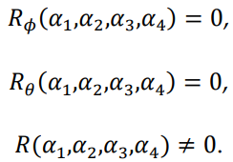
6
I
Research
Singularity in Attitude-Altitude Linearization in Tiltrotors
Design a robust gait:
where
Let
Notes:
Since neither phi nor theta is determined, we expect a robust gait not influenced by roll or pitch.
In a robust gait, for any small roll or small pitch, the determinant is non-zero.
Here is how we find the robust gait.
Firstly, linearize the determinant at zero roll zero pitch.
The result yields:
The coefficient of phi times phi plus the coefficient of theta times theta plus the remaining term.
Since both phi and theta are uncertain in this problem, we assign both the coefficients of phi and theta zero.
By doing so, the contributions of the uncertain phi and theta are suppressed.
Further, to let the left side be nonzero, the remaining term should be nonzero.
The resulting gait is believed robust to the uncertain attitude.
So, we design the gait based on these 3 coefficients.

Slide 41
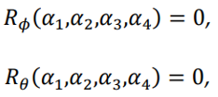

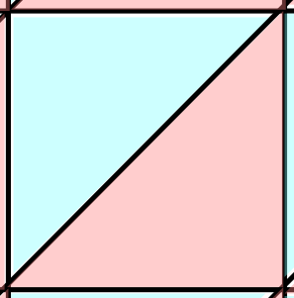
7
I
Research
Singularity in Attitude-Altitude Linearization in Tiltrotors
Notes:
Following this method, I finally found a theorem called the Two color map theorem.
The Two color map theorem tells us how to design the robust gait, alpha1, alpha2, alpha3, alpha4.

Slide 42
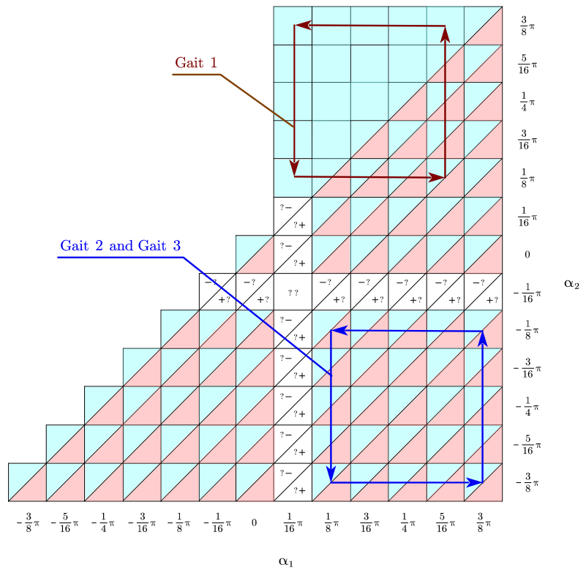
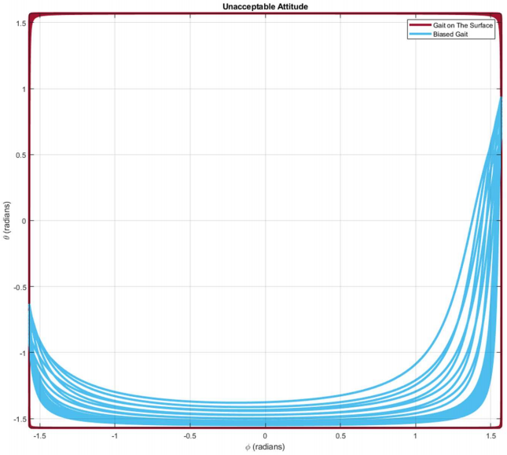
8
I
Research
Singularity in Attitude-Altitude Linearization in Tiltrotors
Gait 3
Notes:
This is the unacceptable attitude figure, as we introduced earlier.
It is a roll pitch diagram.
All the curves inside represent the attitudes that the tilt-rotor should not touch.
They are from 2 cases.
The red curves are the unacceptable attitudes if the tilt-rotor adopts the gait following the two color map theorem.
The blue curves are the unacceptable attitudes if the tilt-rotor adopts a gait not following the two color map theorem.
Clearly, the gait following the two color map theorem is more robust.
Because the red curves leave more space in the middle.

Slide 43
9
I
Research
Singularity in Attitude-Altitude Linearization in Tiltrotors
Gait 3
Notes:
As we mentioned, there are some singular attitude areas that the drone is not supposed to travel to.
Inspired by this, it is tempting to further this research domain with the control barrier function.
Control barrier function, also known as CBF, is a useful tool to restrict the controlled object with some constraints.
Here, the constraint is the singular attitudes.
Also, the CBF can be used to avoid the input constraint in my controller.
I am motivated to play with them.

Slide 44
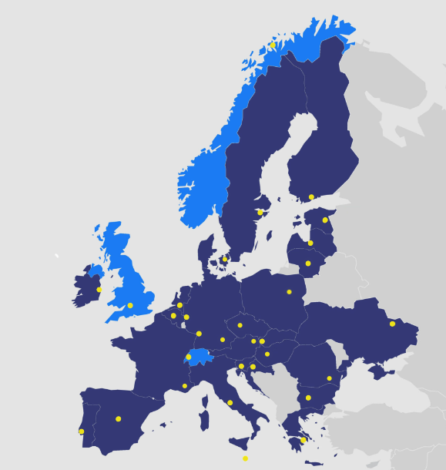



10
I
Research
Notes:
From the next month, I will join a research project with EUROfusion.
It is to control a robotic arm for the nuclear fusion.
To avoid the collision between the robotic arm and the equipment of the reactor, the control barrier function is equipped.
So, I will also make a deep investigation into the control barrier function with the model of the robotic arm.
Those are my research interests.

Slide 45
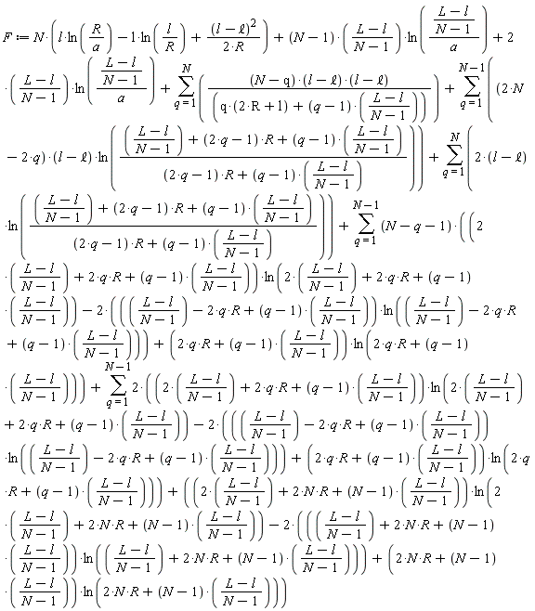
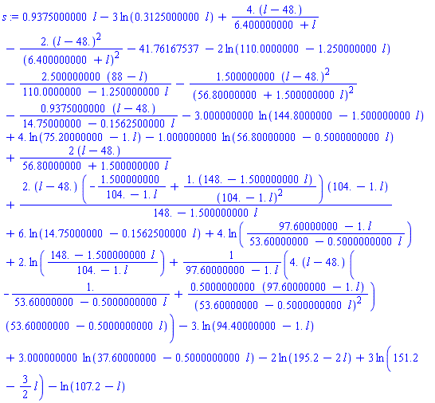
11
II
Teaching Concept
Write the complicated formula directly?
Notes:
As for my teaching concept.
I never think it is a good idea to put down the complicated formula directly in my class.
I always pretend that I am also a student learning the knowledge for the first time.
As a student, I don’t like seeing the complicated formula directly.
Without the explanation, it would be a headache.
So, I do not support give lectures by simply putting down the formulas.

Slide 46


12
II
Teaching Concept
Class for everyone.
able to follow
for advanced researchers
Notes:
Instead, I will make the necessary deduction with the students.
I understand that students may have different prior knowledge.
By deducing step by step, the beginners can also follow the whole picture.
The advanced researchers, on the contrary, will also benefit from the deducing process.
It will sometimes give the inspiration for his or her research.
The mathematical deduction can sometimes be transplanted maybe from the most basic and simplest knowledge.

Slide 47
13
II
Teaching Concept
Play with it!
The program is provided on GitHub.
The Altitude of The Quadrotor
https://github.com/HansOersted/trial_lecture
Notes:
At last, I encourage the students to play with the simulator.
When learning a new control algorithm, the best way can be playing with it.
So, I make my controller open-source on GitHub.
The students can clone and play with it while learning.
This simulator can be used beyond the educational purpose.
There can be young researcher interested in this domain.
They can build their own controller in this simulator and make publications.

Slide 48
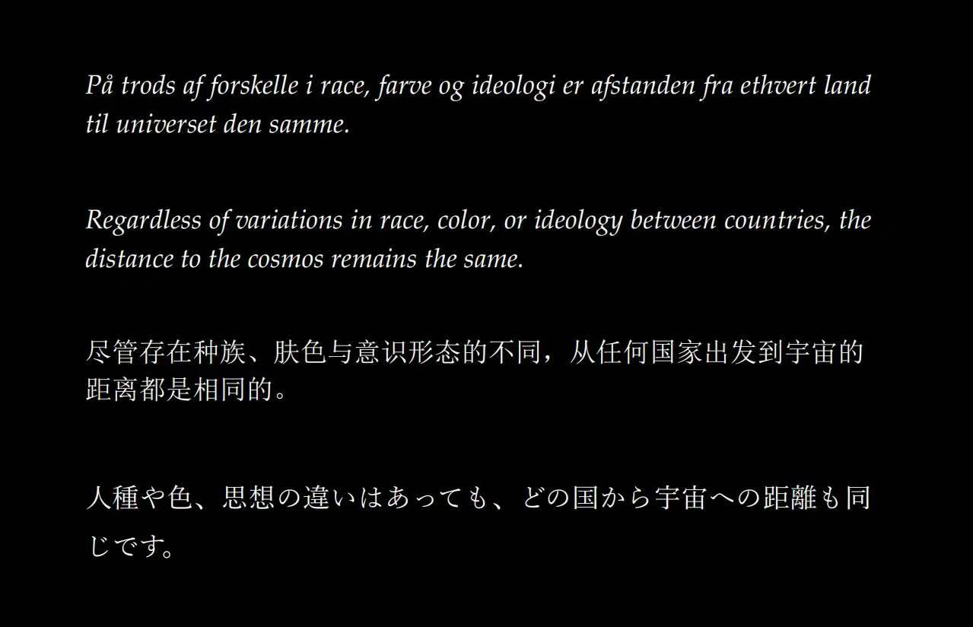
14
II
First Page
Notes:
Let me conclude this presentation.
This is the first page of my doctoral thesis.
I put this sentence here because:
I hope every student coming to Austria from different countries, starting at different levels, can always enjoy and learn something from my lecture.

Slide 49
10/17/2024
Ph.D. in Aeronautics and Astronautics
Thank you for
listening
Shen
Notes:
Thank you for your listening.
This is the real end of my presentation.

